Slide 1
Bayes Theorem and the Bayesian Change Point Detection

Slide 2
Bayes Theorem
P(A|B) = P(A and B) / P(B) P(B|A) = P(B and A) / P(A)
Since P(A and B) = P(B and A),
P(A|B)P(B) = P(B|A)P(A)
The divide both sides by P(B)
[P(A|B)P(B)] / P(B) = [P(B|A)P(A)] / P(B)
P(A|B) = [P(B|A)P(A)] / P(B)
This is Bayes’ Theorem

Slide 3
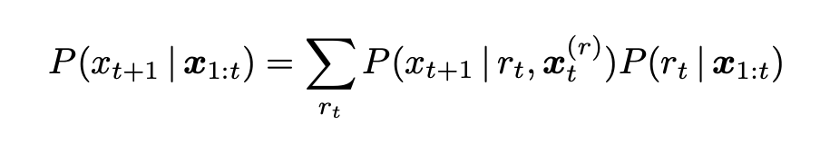
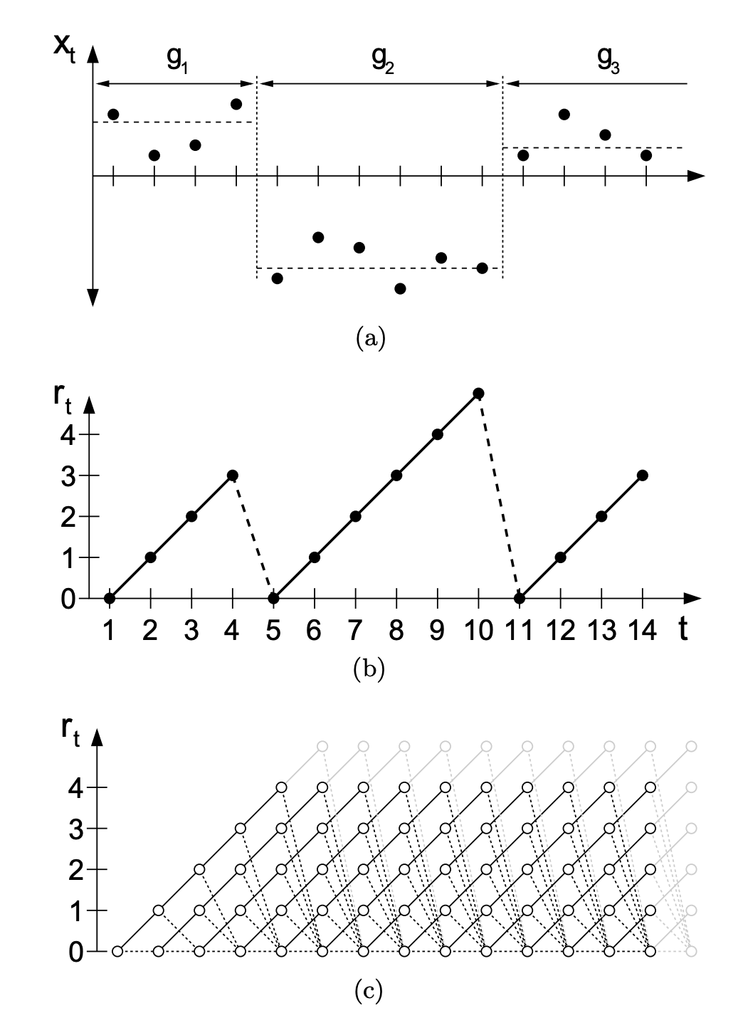
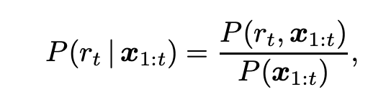
Bayesian Change Point Detection Formulas
Finds the marginal predictive distribution
Finds the posterior distribution

Slide 4
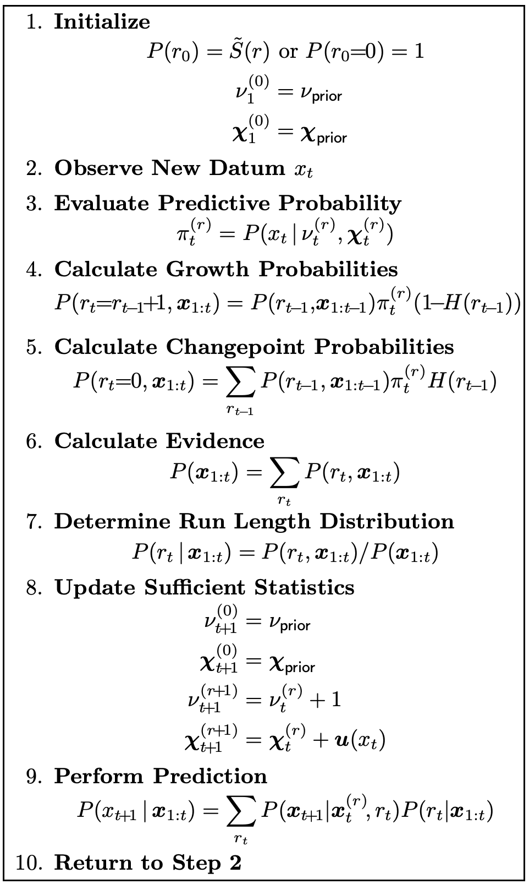
The Algorithm

